Slide 1

Customer Churn
Prediction

Slide 2
Introduction
Customer churn prediction is the process of identifying customers who are likely to leave/stop using a product or service.

Slide 3
Reasons for customer churn
Poor Customer Service: Slow, unhelpful, or impersonal support drives customers away.
Unmet Expectations: Products or services fail to meet promises or customer needs.
High Prices: Customers perceive better value elsewhere or cannot afford rising costs.
Lack of Engagement: Minimal interaction or communication leaves customers disconnected.
Product Issues: Frequent problems or outdated offerings lead to dissatisfaction.
Competitive Offers: Rivals provide better deals, features, or experiences.
Loss of Need: The customer no longer requires the product or service.
Personal Reasons: Lifestyle, financial changes, or relocations affect usage.
Trust Issues: Breaches, disputes, or unethical practices erode confidence.
No Loyalty Incentives: Lack of rewards or recognition makes customers feel unvalued.

Slide 4
Industries
Telecom Industry
Insurance Sector

Slide 5
Telecom Industry
Metrics:
Data usage(Mb)
Login patterns
Bill Amount
Payment delay days
Network latency
Packet loss percentage
Download speed(Mbps)
Models tested: PyTorch, TensorFlow, CatBoost, XGBoost Best performance: CatBoost with the highest ROC-AUC Feature engineering: 6-month summarization Trend

Slide 6
Insurance Sector
Core metrics:
Customer Age
Policy Age
Average claim processing time
Vehicle changes
Month to renewal
Vehicle value
Total Claims
Model architecture: A neural network with improved feature preprocessing Key innovation: Adding time-based features like policy duration and renewal timing SMOTE implementation: Used to address class imbalance

Slide 7
Machine Learning Models
Base models
Ensemble methods
DecisionTreeClassifier
GaussianNB (Naive Bayes)
KNeighborsClassifier
SVC (Support Vector Classifier)
MLPClassifier (Multilayer Perceptron)
LogisticRegression
RandomForestClassifier
AdaBoostClassifier
GradientBoostingClassifier
ExtraTreesClassifier
XGBClassifier CatBoostClassifier

Slide 8
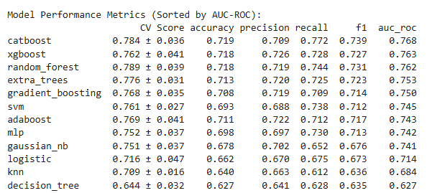
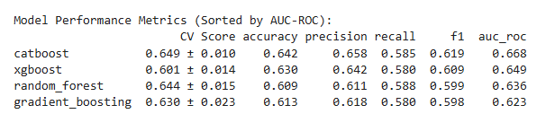
Performance Metrics and Evaluation
Area Under the ROC Curve (AUC)
F1-Score
Precision and Recall
Accuracy
Cross Validation Score (CV score)

Slide 9
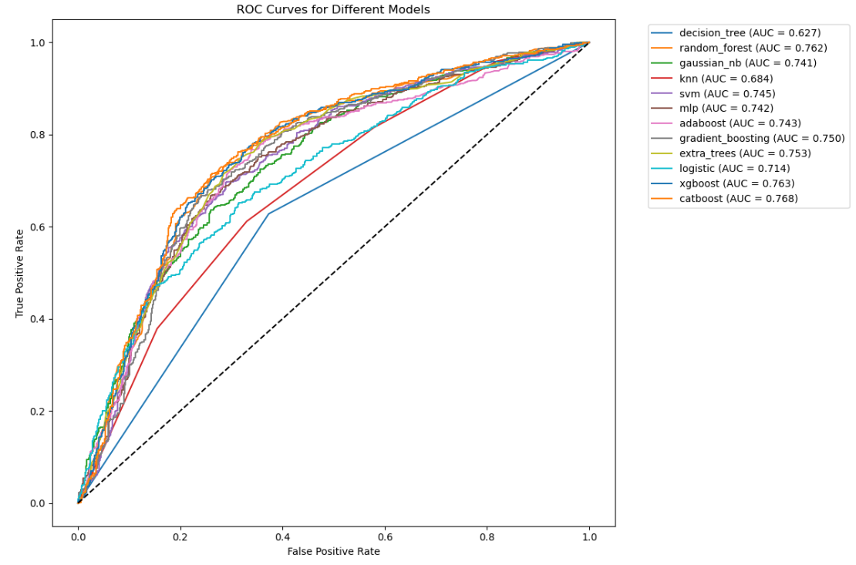
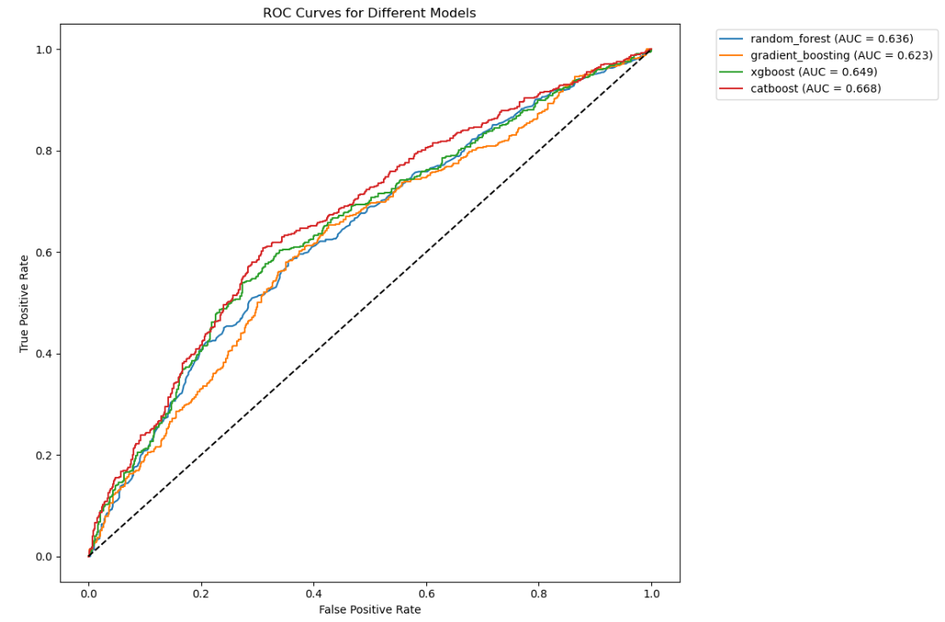
ROC Curves
Telecom
Insurance

Slide 10
Tools
Frontend - React JS
Backend (using Flask) - Python
To handle data processing, model training, and make predictions -
Scikit-learn
TensorFlow
PyTorch

Slide 11
Architecture Overview
Frontend (React)
Interactive Forms
Dynamic UI Updates
Backend (Flask)
REST API Endpoints
ML Model Integration
Data Preprocessing

Slide 12
Frontend Features

Slide 13
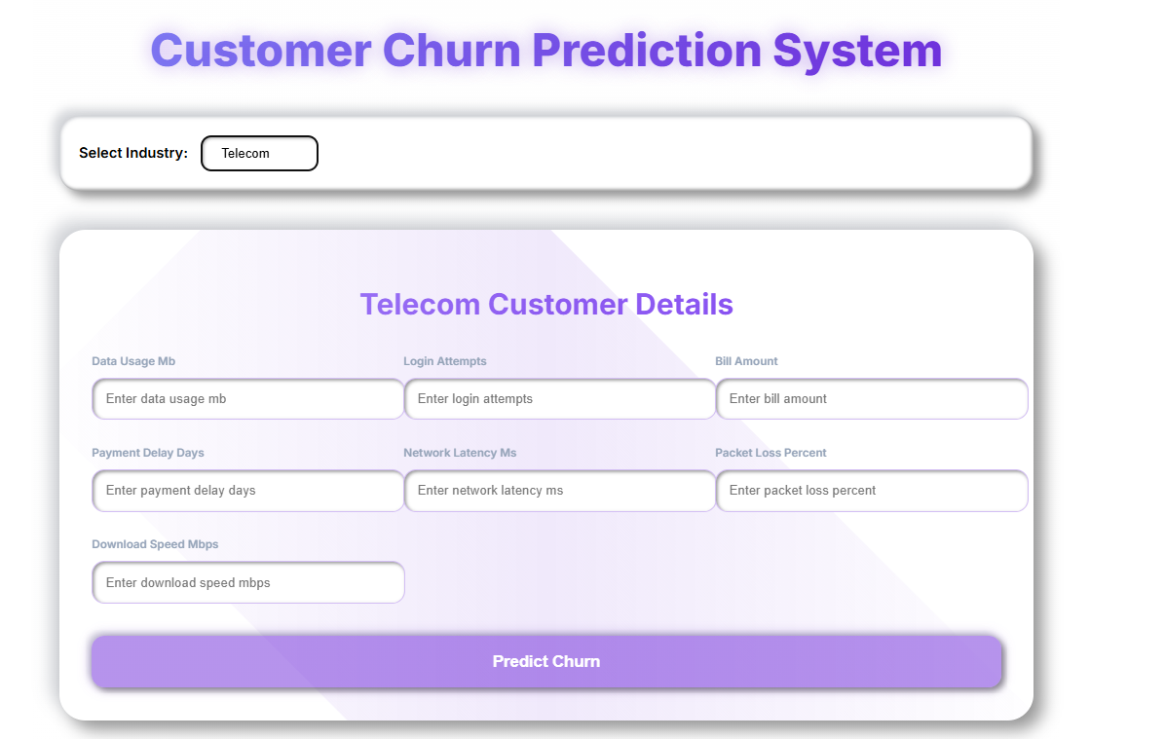
Telecom Form
Data usage(Mb)
Login patterns
Bill Amount
Payment delay days
Network latency
Packet loss percentage
Download speed(Mbps)

Slide 14
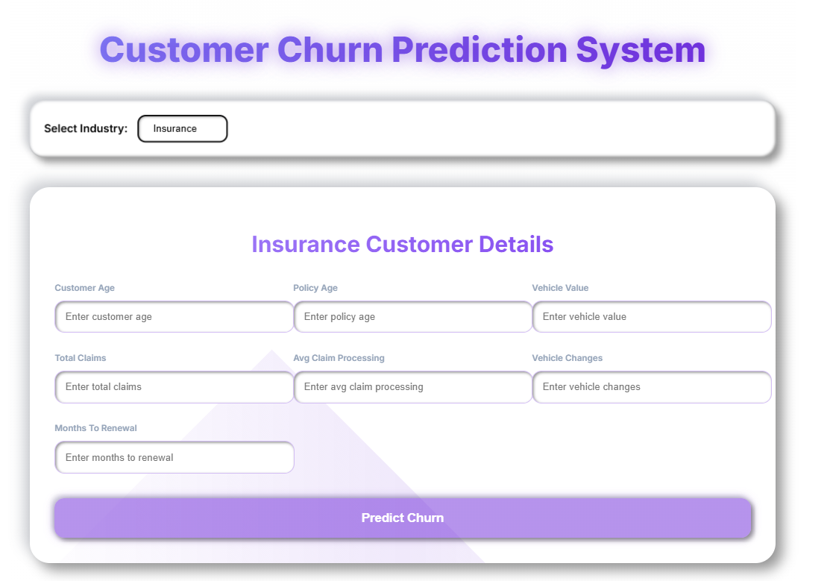
Insurance Form
Customer Age
Policy Age
Average claim processing time
Vehicle changes
Month to renewal
Total Claims
Vehicle value

Slide 15
Backend Processing
Data Processing Pipeline
Feature Preprocessing
Data Scaling
Model Prediction
Risk Classification
Output
Churn Probability Score
Risk Category (High/Medium/Low)

